Slide 1
System Administrator Guide
Tao Zimmerman, Colton Hulce, Louis Najdek, William Atwood

Slide 2
Information Disclaimer
The testing performed was done in a safe environment, with no connection to any network. We are not responsible for any damages caused by attempting the content depicted in this presentation.

Slide 3
Backups
Regularly scheduled backups will lower downtime and mitigate damage from an attack
3 - 2 - 1 rule
3 data copies
2 data sources
1 off site storage
Cloud storage
Backups are the most critical aspect of recovery from a ransomware attack for an organization

Slide 4
Backups
Cloud Storage Allows for online management There are many services available that you can pick and choose from, many of which offer solid online management and monitoring. | Offsite Storage Disconnected from your network You can control where it’s stored and how.

Slide 5
End-User Training & Awareness
Build habit
Train awareness
Remain positive

Slide 6
Maintaining Services & Utilizing Anti-Virus Programs
Keeping your software updated is an important aspect to avoiding exploitation
Ensure you are on the latest update/patch for your software and OS
Assess that the software on your network is all necessary
With your organization’s budget in mind, look into anti-virus programs, intrusion detection systems (IDS) and intrusion prevention systems (IPS) options for your systems as an added layer of security.

Slide 7
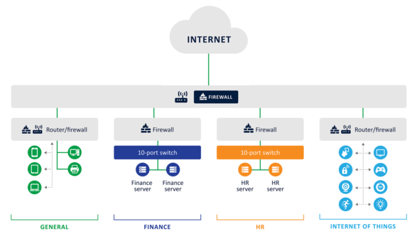
Segmentation & Least Privilege
https://www.securityinfowatch.com/cybersecurity/article/21130437/network-segmentation-the-first-line-of-defense

Slide 8
Vulnerability Assessments and Penetration Testing
Depending on a business’ budget, it may be useful to look into this to further bolster your cyberdefense.
There are program alternatives that will not be as thorough, but are more affordable for smaller budgets.

Slide 9
Response
How will each level of your organization respond to a ransomware attacK?
Detection
Prevent Spread
Evaluate Scope
Identify Threat
Response Options

Slide 10
Detection
Noticing unusual activity on the network
Is there any clear indicator of compromise?
Are files showing up or moving to unusual places?

Slide 11
Prevent Spread
Figure out all affected devices
Remove all contacts between affected devices and the network
If it has spread, it may be beneficial to pull healthy devices off of the network

Slide 12
Evaluate Scope
What has the malware managed to impact?
What data has been stolen?
How many devices have been affected?

Slide 13
Identify Threat
What running programs are apart of the malware?
Does the documentation about the malware help identify programs?
What information can you determine about the malware?

Slide 14
Response Options
Can we determine that sensitive data was taken?
Will it be quicker to revert everything to a backup?
Are there any other options other than negotiating?

Slide 15
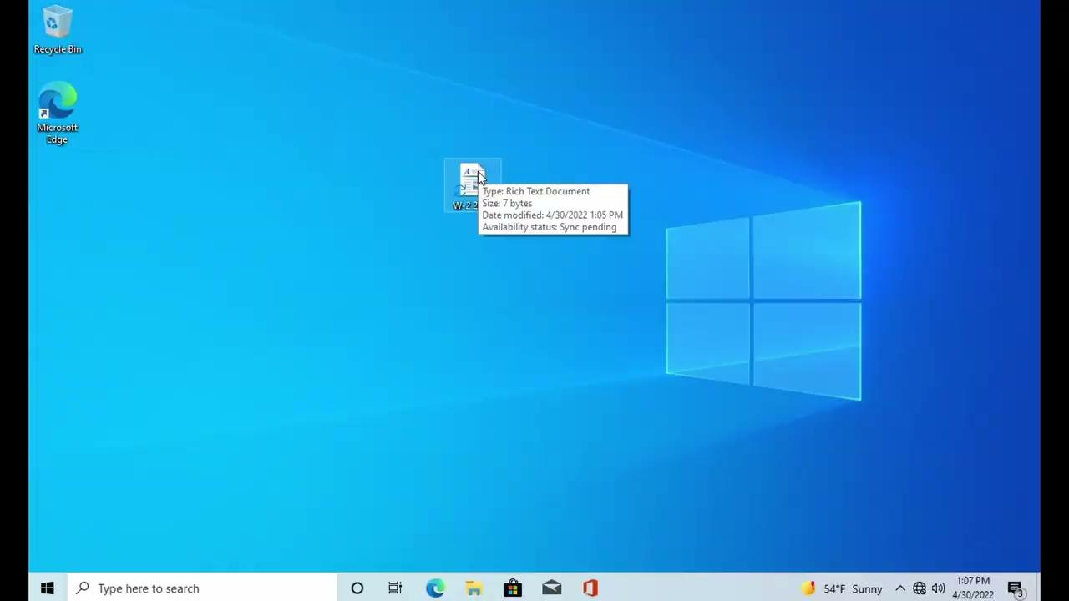
Ransomware Example - Wannacry

Slide 16
Sources
Papez, Neko. Shields, Robert. “Countermeasures for Ransomware”. proofpoint. Proofpoint. 09
Sep 2021. https://www.proofpoint.com/us/blog/security-awareness-training/countermeasures-ransomware.
“Ransomware: Facts, Threats, and Countermeasures”. Center for Internet Security. Center for
Internet Security. https://www.cisecurity.org/insights/blog/ransomware-facts-threats-and-countermeasures.
Virgillito, Dan. “Security+: How to identify Indicators of Compromise and differentiate different
types of malware [updated 2021]”. Infosec. Infosec Institute, Inc. 08 Mar 2021. https://resources.infosecinstitute.com/certification/security-how-to-identify-indicators-of-compromise-and-differentiate-different-types-of-malware/
“WannaCry Ransomware Using SMB Vulnerability”. NHS Digital. NHS Digital. 12 May 2017.
https://digital.nhs.uk/cyber-alerts/2017/cc-1411.

